Slide 1

ONE STOP SOLUTIONS Empowering Education by 1 Click….
Raghav (Reg no. 12217111)
Hitesh bhandari (Reg no. 12220814)

Slide 2

INTRODUCTION
Say goodbye to wasted time searching for resources, especially during exams. We offer easy access to all study materials in one place, boasting a user-friendly interface for seamless navigation. Save time, study smarter with us.

Slide 3
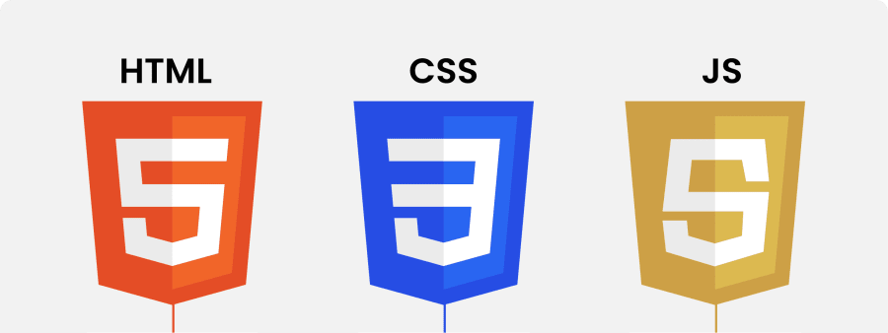
LANGUAGES USED:
HTML: Defines the basic layout of our website
CSS: CSS has been used to enhance the website and add various formatting and styles to it.
JAVASCRIPT: Javascript has been used to create dynamic and interactive web pages.
JQUERY: Jquery is used to make the js code easier and wrap the multiple lines into single line of code.
BOOTSTRAP: Bootstrap is used in our website to add responsiveness to it.

Slide 4

PURPOSE
The purpose of 'One Stop Solutions' is to
revolutionize education by offering a
centralized platform for accessing diverse
study materials. Our goal is to streamline
the learning journey, promote collaboration
among learners, and empower individuals
worldwide. We prioritize inclusivity, accessibility,
and data security to ensure a trusted and
enriching educational experience for all users.

Slide 5

PROBLEM ANALYSIS
The challenges we addressed that students generally faced are :
Hassle and time waste
Insufficient resource retrieval
Limited availability

Slide 6

WHY TO CHOOSE US ?
Centralized Access
Collaborative Learning
User-Friendly Interface
Adaptive to curriculum

Slide 7
Glimpse of website:

Slide 8
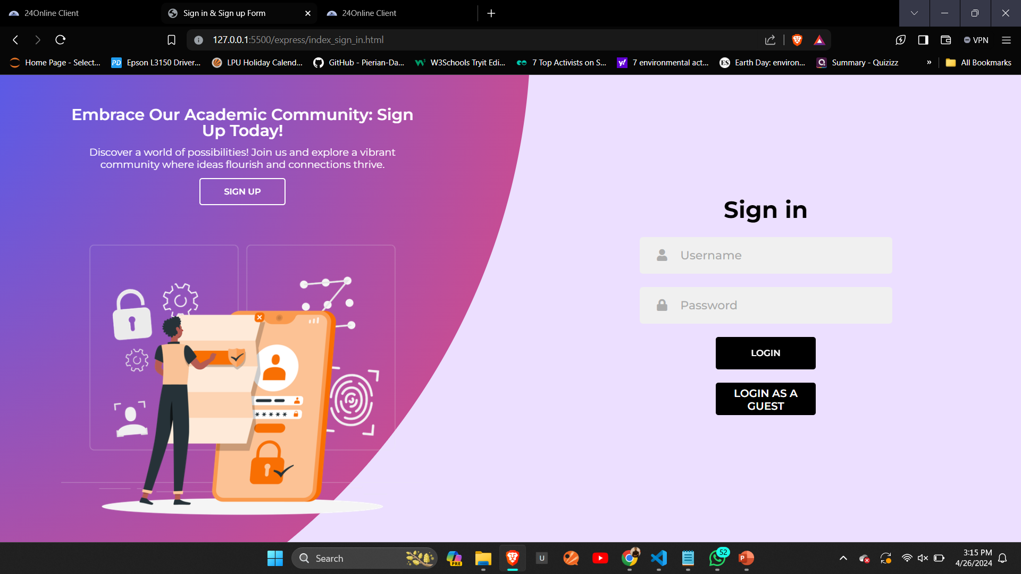

Slide 9
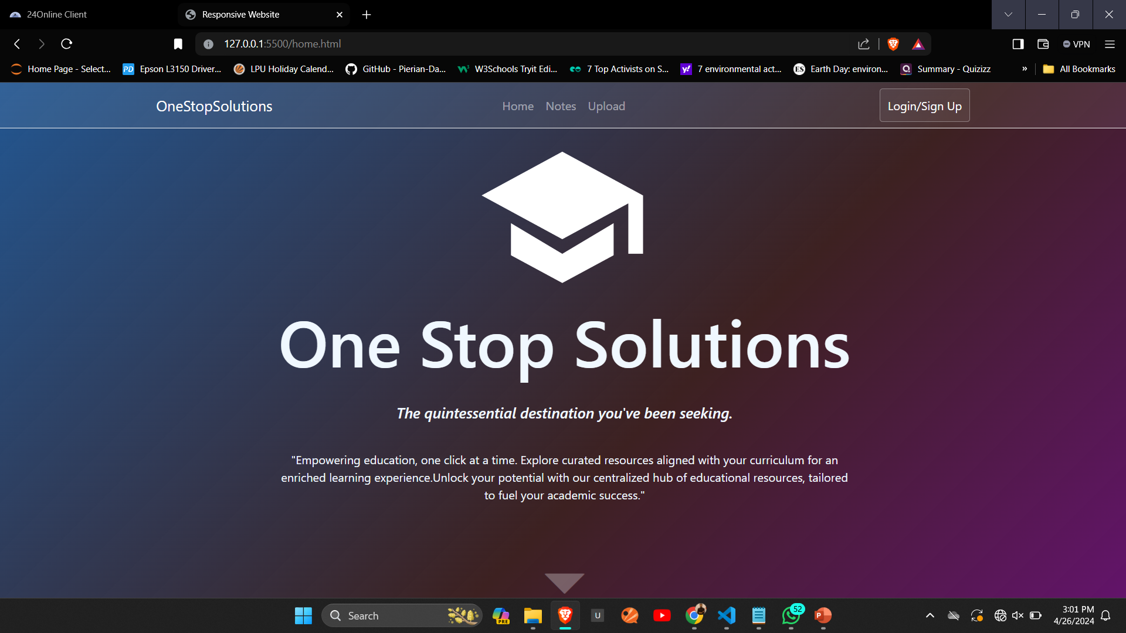

Slide 10
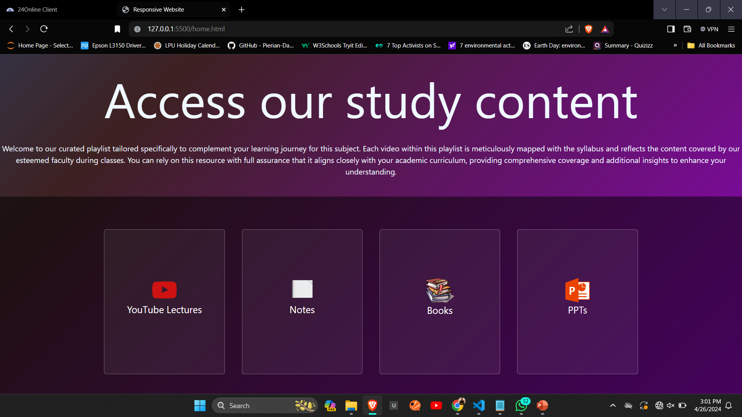

Slide 11
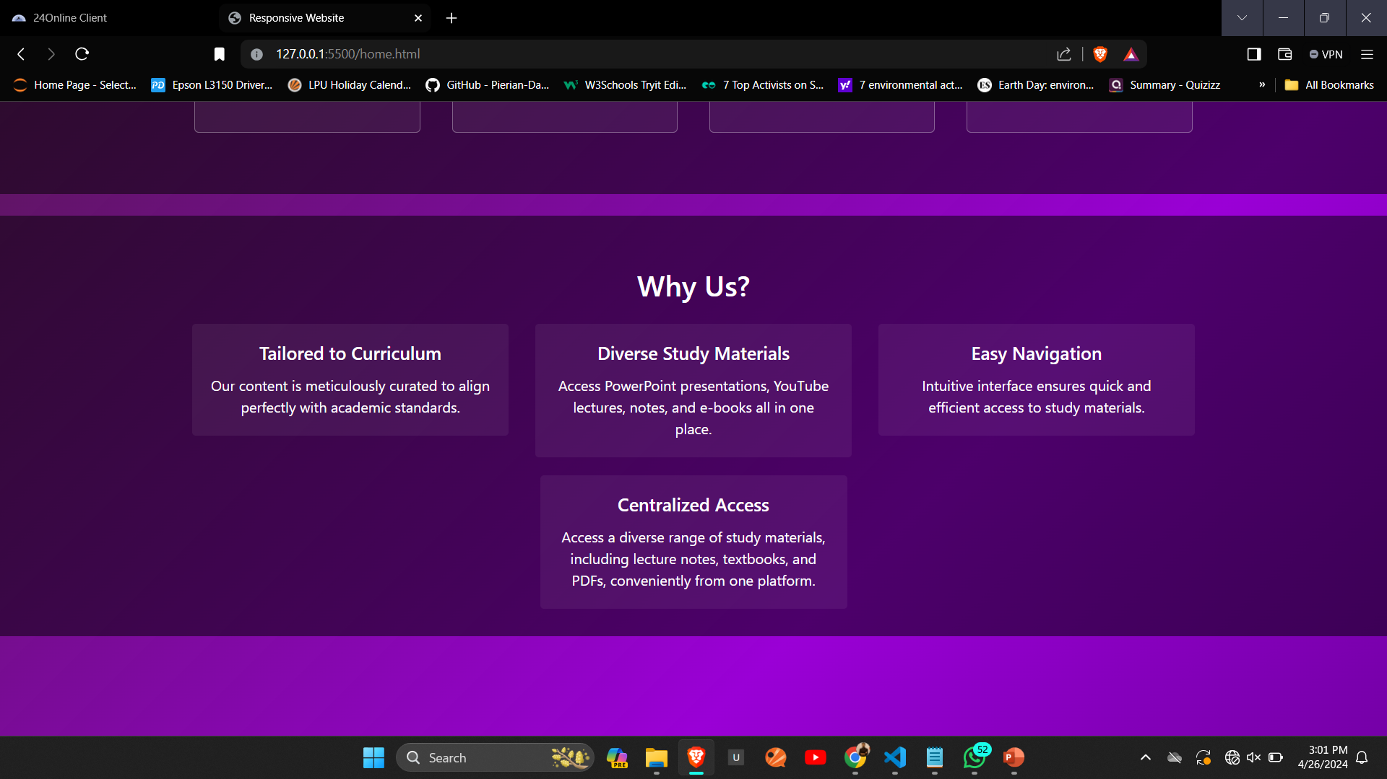

Slide 12
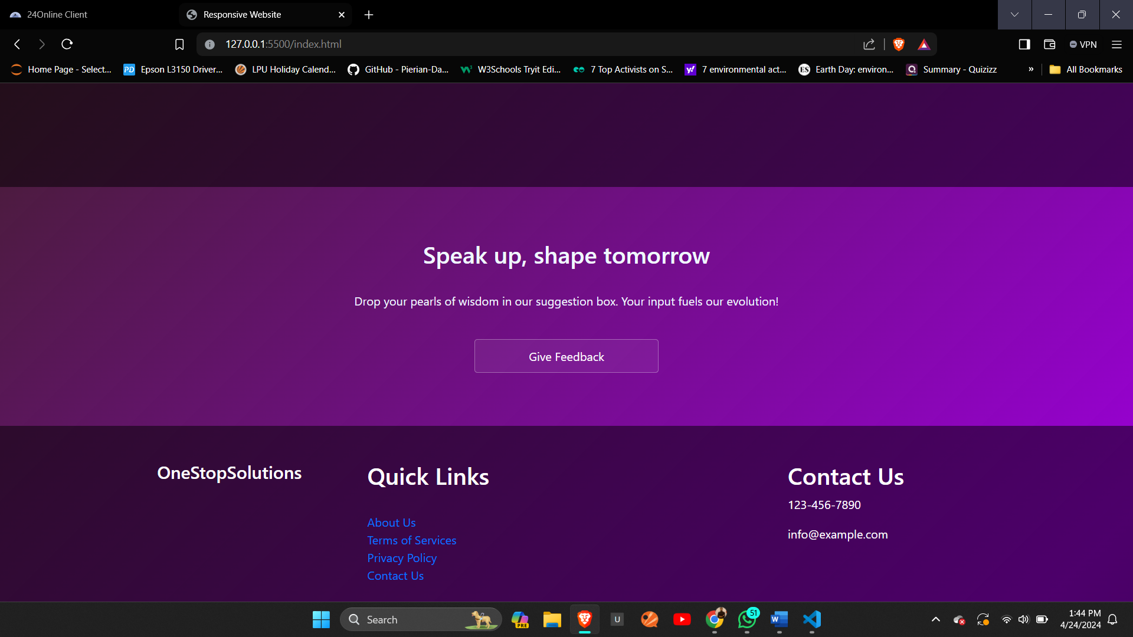

Slide 13
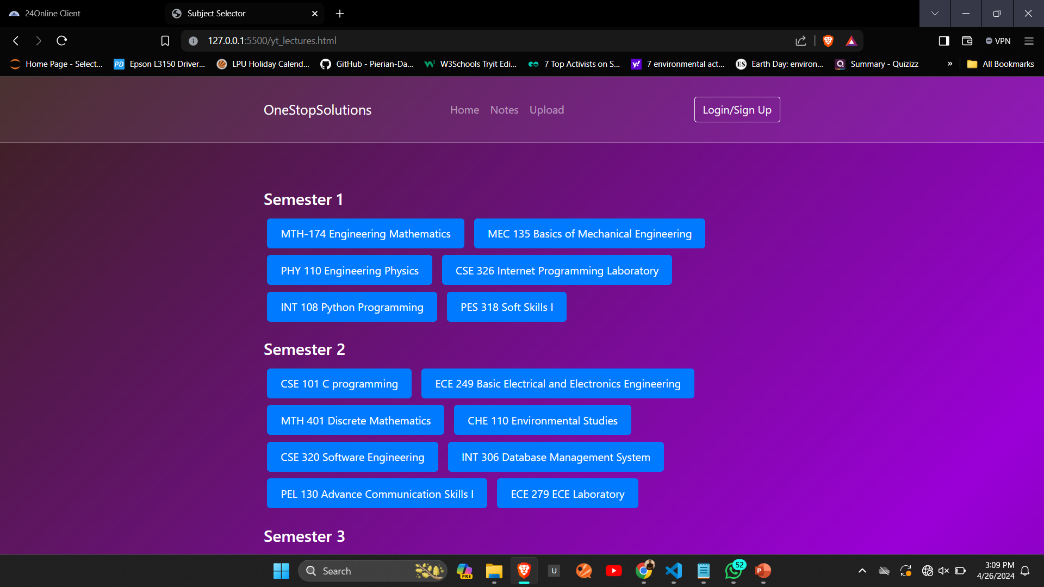

Slide 14

CONCLUSION
In closing, "One Stop Solutions" stands
at the forefront of educational innovation,
streamlining access to diverse study materials.
Together, we pave the way for an inclusive
learning environment, revolutionizing the
educational landscape one click at a time.

Slide 15

THANK YOU

